Slide 1

Cultivating a Culture of Learning and Deliberate Practice
Notes:
2 years ago I attended a conference
At an open space session
I paired with a technical coach
I had never heard of a role like that
Since then I’ve learned a lot about it; samman coaching, ensemble working, and learning hours.
I brought that knowledge to my team that was having trouble using pairing and TDD effectively
That team went from average to high performing over the next year
Delivering several times a week and having near zero defects
I want to share how practice and a simple weekly meeting called Learning Hours can transform your team for the better

Slide 2

Steven Diamante
Technical Consultant at
XP practitioner
Passionate about technical excellence
Organizer of the Raleigh Software Craftsmanship Community
Musician and daily meditator
Notes:
Started career in XP
Pair programming mostly everyday, mob programming is awesome as well
I’ve been learning TDD my whole career and continue to learn better ways of using it and teaching it
My purpose is to coach development teams on technical excellence
so that they can have more fun and deliver more business value

Slide 3
Learning Goals
Recognize the value that deliberate practice has on your career
Explain why Learning Hours are beneficial
List ways to cultivate a culture of learning
Notes:
Learning Hours start with defining the learning goals for the session.
Learning Hour - A time to learn together and practice technical skills

Slide 4

Current state of our profession
Number of developers double every 5 years
Prioritizes speed over quality
Learning is expected to be done outside of working hours
Tech Debt is a major problem for many teams
Top 3 obstacles to digital transformations are:
Gaps in technology skills and knowledge
Budget constraints
Technical Debt
According to Foundry Survey 2023
Notes:
Industry of Amateurs
We lack a professional code of standards
Top 3 obstacles to digital transformations are:
Gaps in technology skills and knowledge
Budget constraints
Technical Debt
“86% report their organization has been impacted by
technical debt over the past 12 months. The top areas
affected are the ability to innovate, decreased productivity, missed deadlines, and increase outages.”
Foundry Survey 2023

Slide 5

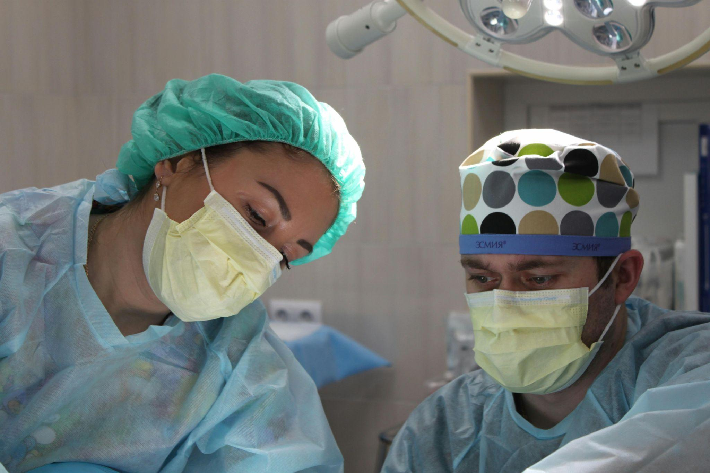

How do other professions approach practice?
Deliberate Practice
Notes:
Athletes
Drills / focused skill improvement
Coaches (feedback)
challenging
Doctors/Surgeons
Simulation training - practice complex medical procedures or emergency scenarios in a controlled environment
Pilots
Every 6 months, navy pilots have to test out on different planes to be able to keep flying.
When they fly there is an expert level pilot there to critic and correct every little action the pilot takes
"We don't rise to the level of our expectations, we fall to the level of our training.”

Slide 6
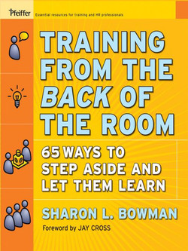
What is a Learning Hour?
A safe environment where teams learn together
Typically an hour long (weekly)
4C Learning Model from Sharon Bowman’s Training from the Back of the Room
Connect
Concept
Concrete
Conclusion
Notes:
Sharon Bowman's (Training from the Back of the Room)
4 C Learning Model
It’s a way to gradually introduce new ideas and skills into your organization.
"each person who comes to your learning hour has a unique background, and what they are going to learn needs to be integrated with what they already know for it to stick" - Technical Agile Coaching with the Samman Method
Connect:
Get people in the right headspace for learning about the topic together (helps making connections from ideas they already know to the new ideas)
Concept:
Introduce new skills or information you want participants to learn.
Concrete:
Hands-on exercises to practice skills or figure out how things work
Conclusion:
An opportunity for people to consolidate and internalize what they've learnt
-----------------------------------------------------------------
Pull up the site and navigate around
------------------------------------------------------------------------------
Explain feedback that the team had on Learning Hours
- so much better than lectures
- love that it's interactive
- safe space where we can try things out

Slide 7
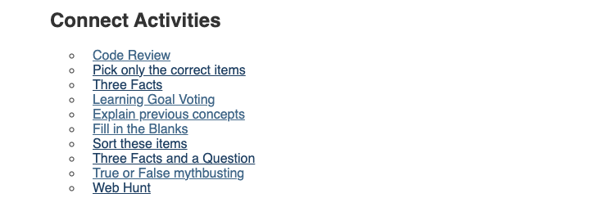

“Link learners to learners and learners to the topic”
- Sharon Bowman (Training from the Back of the Room)
engaging activities
transfer of learning
primes participants’ brains for learning
fosters connection between the learners
Notes:
This is the Connect part of the learning hour where we talk to each other about what we already know
This helps the facilitator and the other participants understand what everyone already knows about a topic.
Transfer of learning - the use of previously acquired knowledge and skills in new learning or problem-solving situations
<a href="https://www.freepik.com/free-vector/cartoon-brain-having-idea_138418663.htm#query=brain%20clipart&position=7&from_view=keyword&track=ais&uuid=3a805856-30a7-4477-a0ba-4e26ba963fd9">Image by grmarc</a> on Freepik

Slide 8
Connect: Fill in the Blanks
focus
manner
deliberate
focusing
As seasoned developers, we understand the importance of ____________ practice in honing our skills. Deliberate practice involves breaking down complex tasks into smaller, manageable components and ___________ on improving specific aspects. This approach requires intense _________, continuous feedback, and a commitment to pushing beyond our comfort zones. By engaging in deliberate practice, we can accelerate our learning and elevate our expertise in a focused and systematic _________.

Slide 9
Connect: Fill in the Blanks
As seasoned developers, we understand the importance of __deliberate__ practice in honing our skills. Deliberate practice involves breaking down complex tasks into smaller, manageable components and __focusing__ on improving specific aspects. This approach requires intense __focus__, continuous feedback, and a commitment to pushing beyond our comfort zones. By engaging in deliberate practice, we can accelerate our learning and elevate our expertise in a focused and systematic __manner__.

Slide 10

Concept: Deliberate Practice
focused skill development
slightly beyond one's current level of proficiency
feedback and iteration
repetition
Notes:
Refactoring
|
|
Renaming – extracting methods
Photo by Mikhail Nilov: https://www.pexels.com/photo/archer-aiming-on-a-target-6620743/

Slide 11

Learning vs. Performance
Accumulation of learning over time
Execution of a skill in a specific context
Notes:
Little Timmy here is learning to ride a bike My guitar playing skill hasn’t really increased by much since this photo was taken 10 years ago

Slide 12
Concrete: What do we learn?
✅ TDD, refactoring, legacy code techniques, clean code, test design, etc.
✅ Collaborative ways of working
✅ Keyboard shortcuts & our tools
✅ Different approaches to solving coding katas
✅ Techniques that can be applied to our real work
❌ Frameworks, libraries, languages

Slide 13
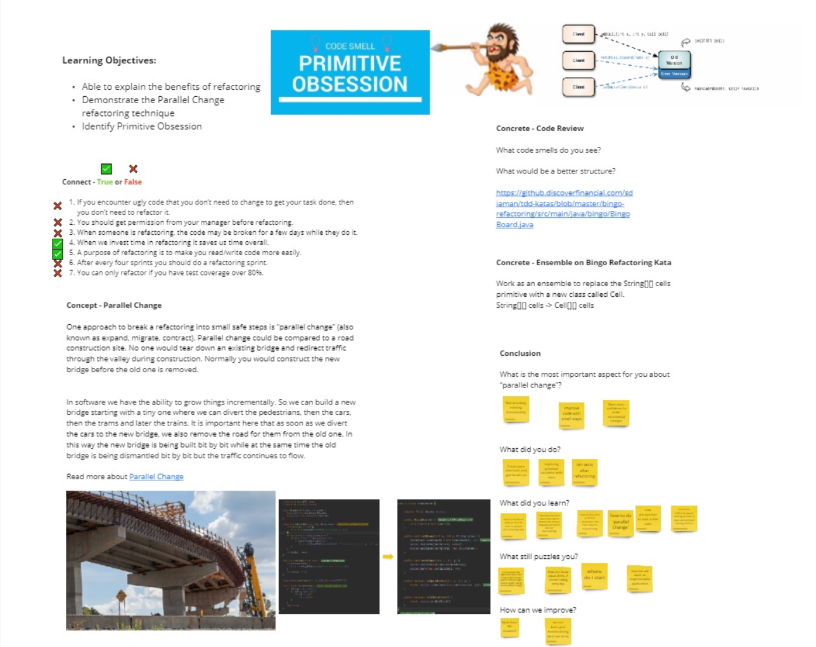

Slide 14
How do we work? Ensemble
We learn from the failures and the successes
Everyone gets a chance to do and see
Continuous feedback from coach and peers
Unique insights and skills available
Fosters sense of community
Notes:
What is Ensemble? Different roles: Typist, Navigator…
Photo by cottonbro studio: https://www.pexels.com/photo/3-women-playing-musical-instruments-7095028/

Slide 15

Guided Learning Hours

Slide 16

How to convince your team?
Explain the long term benefits
Higher Quality Deliverables
Increased Collaboration and Innovation
Continuous Improvement
Slack time
Start with What’s not to like about this code
Frame it as an experiment
Notes:
In Tom Demarco’s book: Slack
Slack means we don’t work every second of the day, we don’t allocate every person to 100%.
Slack is essential for
promoting creativity, innovation, and resilience
within organizations by providing space for
experimentation, reflection, and learning
"Let's try it for a month and reflect on how it went. If it's not helping us, we'll stop."

Slide 17
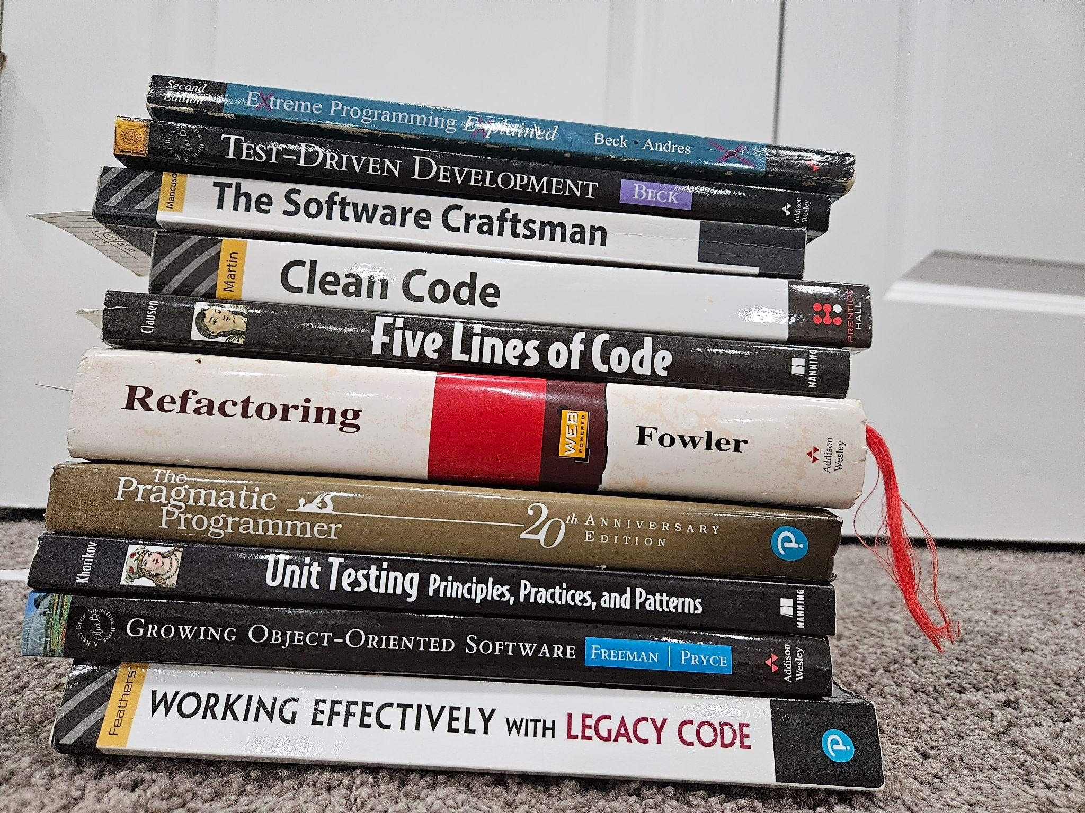
Culture of Learning
Share articles, podcasts, videos, and books with your coworkers
Practice katas and invite your teammates to pair with you
Start having weekly Tech Retros and/or Tech Talks

Slide 18

How to get started with Learning Hours
Add it to the weekly schedule
Use a Lean Coffee to brainstorm learning topics
Pick a learning hour
Set up a shared workspace like Miro
Leverage Emily Bache’s Guided Learning Hours

Slide 19
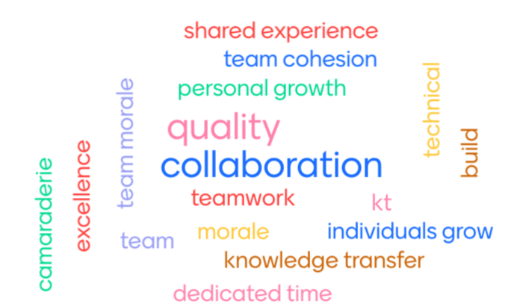
Conclusion:
Why are Learning Hours beneficial?
Notes:
Tell someone close to you a word or two about what makes Learning Hours beneficial

Slide 20
Active Recall: True or False
Learning hours are dedicated time slots allocated within a team's schedule specifically for learning and skill development activities

Slide 21
Active Recall: True or False
Learning hours are dedicated time slots allocated within a team's schedule specifically for learning and skill development activities
Learning hours are primarily focused on formal training sessions led by external instructors or trainers

Slide 22
Active Recall: True or False
Learning hours are dedicated time slots allocated within a team's schedule specifically for learning and skill development activities
Learning hours are primarily focused on formal training sessions led by external instructors or trainers
Deliberate practice involves mindlessly repeating the same task over and over again without any focus or intention

Slide 23
Active Recall: True or False
Learning hours are dedicated time slots allocated within a team's schedule specifically for learning and skill development activities
Learning hours are primarily focused on formal training sessions led by external instructors or trainers
Deliberate practice involves mindlessly repeating the same task over and over again without any focus or intention
Deliberate practice involves identifying specific areas for improvement and designing practice activities that target those areas

Slide 24
Active Recall: True or False
Learning hours are dedicated time slots allocated within a team's schedule specifically for learning and skill development activities
Learning hours are primarily focused on formal training sessions led by external instructors or trainers
Deliberate practice involves mindlessly repeating the same task over and over again without any focus or intention
Deliberate practice involves identifying specific areas for improvement and designing practice activities that target those areas

Slide 25
Resources
Samman Technical Coaching
Emily Bache's YouTube Channel
Mob Mentality Show
Path to Programming Blog
Path to Programming YouTube Channel

Slide 26

Questions?

